Slide 1
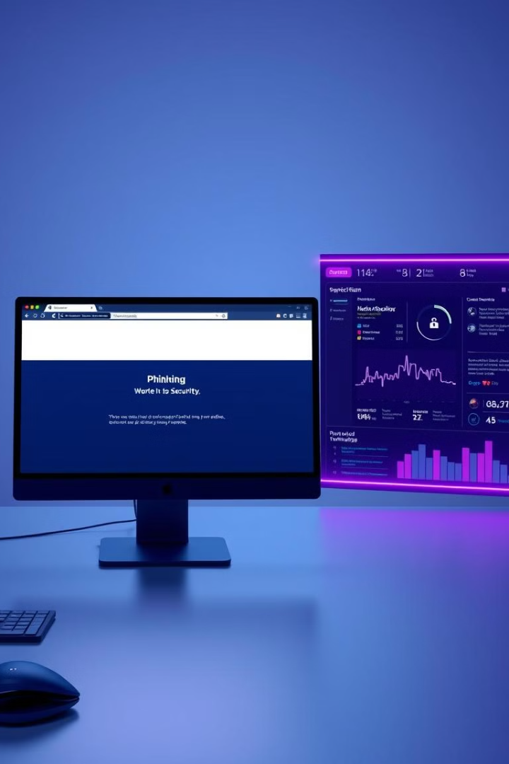
Phishing Website Detection
This presentation explains the development and implementation of an extension designed to identify and prevent phishing attacks on the web. It outlines the project's methodology, key findings, and future directions for enhancing online security.

Slide 2
Problem Statement
Growing Threat
Ineffective Solutions
Phishing attacks, where fake websites designed to steal personal information are increasingly common, pose a significant threat to online security. These websites can appear identical to legitimate platforms, making them difficult to identify.
Traditional approaches, such as manual verification and user awareness campaigns, are often slow and insufficient to combat phishing websites. An automated solution is needed to detect phishing sites quickly and effectively.

Slide 3

Project Goals
1
Automated Detection
2
Real-Time Alerts
3
Enhanced Security
The primary goal of this project is to develop an automated system that can analyze websites in real time for potential phishing attempts.
The system should alert users or administrators to the presence of phishing sites before sensitive data is compromised.
By identifying and blocking phishing websites, the system will help reduce the risks associated with these attacks and improve overall online security.

Slide 4
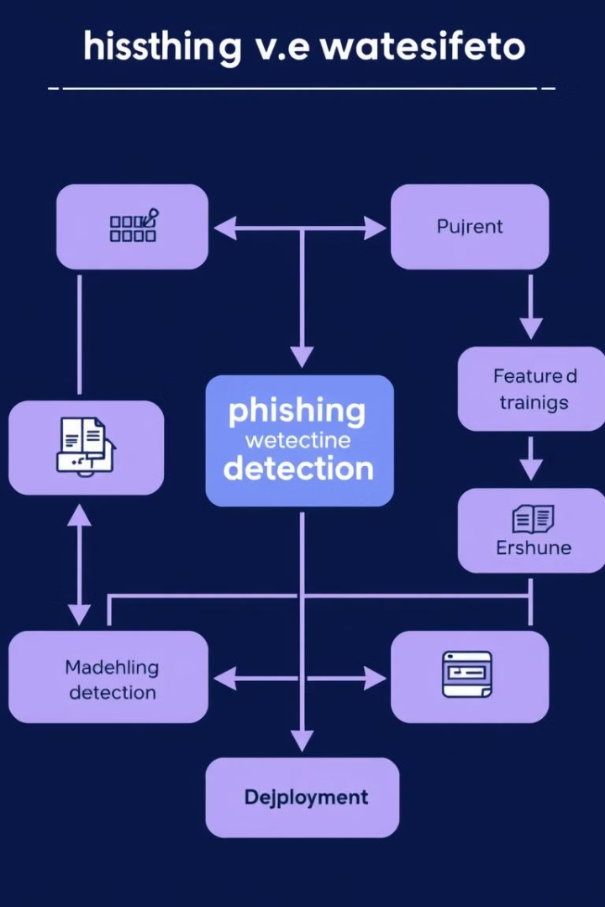
Methodology
1
URL Analysis
The system analyzes the URL for suspicious patterns, such as misspelled domain names, excessive use of special characters, and signs of obfuscation.
2
Content Analysis
Website content is examined for elements like fake login forms, suspicious keywords, and inconsistent HTML structures.
3
Machine Learning
Machine learning algorithms, trained on a dataset of known phishing and legitimate sites, classify websites based on extracted features.

Slide 5
Model Training and Evaluation
Random Forest Classifier
Feature Importance
The system employs a Random Forest Classifier, a machine learning algorithm known for its accuracy in identifying phishing sites.
Features like URL length, special characters, and domain age play a significant role in the classifier's ability to distinguish between phishing and safe websites.

Slide 6



System Integration
Flask API
Chrome Extension
A Flask API enables real-time classification of URLs, allowing the system to analyze and flag potential phishing sites quickly.
A Chrome extension integrates the detection system directly into the browser, alerting users when they visit a suspected phishing website.

Slide 7
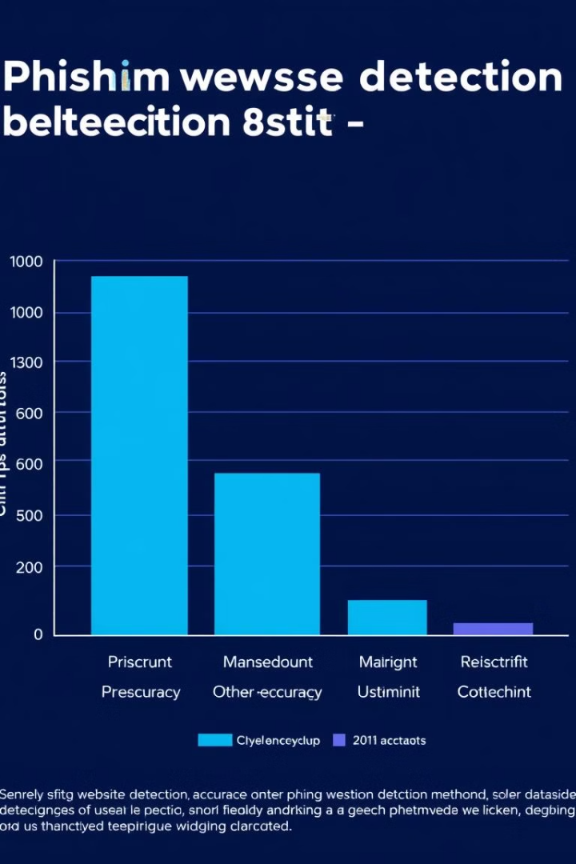
Results and Discussion
87%
Accuracy
The system achieved an accuracy of around 87% in identifying phishing websites, demonstrating its effectiveness in detecting and preventing these attacks.

Slide 8



Challenges and Future Work
Evolving Phishing Tactics
1
As phishing techniques become more sophisticated, the system must be continually updated to maintain its effectiveness.
Content Analysis
2
Enhancing the system with content analysis capabilities, such as image recognition and text analysis, can further improve detection accuracy.
User Feedback
3
Integrating user feedback into the system, providing detailed explanations for flagged websites, and making the Chrome extension more user-friendly are key areas for improvement.

Slide 9
Conclusion
Success
1
The project successfully developed a robust phishing website detection system using machine learning algorithms and real-time integration.
Enhanced Security
2
By identifying and preventing phishing attacks, the system plays a vital role in protecting users and organizations from online threats.
Continued Innovation
3
The system will continue to evolve with future work focusing on improving accuracy, expanding detection capabilities, and enhancing user experience.

Slide 10

Next Steps
The next phase of the project involves further refining the system's accuracy, expanding its capabilities to include more sophisticated phishing tactics, and integrating it into more platforms and browsers. By addressing these goals, we can continue to enhance online security and protect users from the evolving threat of phishing attacks.

